Slide 1
WEB BROWSERS
Done by Sanada Thomas

Slide 2
We will learn about:
How the World Wide Web Works?
How does a web browser work?

Slide 3
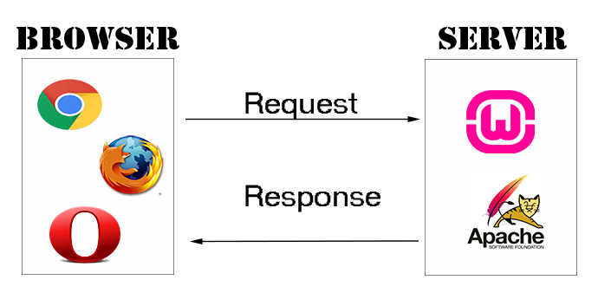
How the World Wide Web Works?
Client-Server Mode
The internet operates on a client-server model. The client, which is your computer, specifically the browser you are using, sends a request to the server to retrieve the page you entered in the browser's address bar. If the page exists, the server will send the HTML page in response; if the requested page does not exist, the server will send a 404 Error code, indicating that the web page does not exist on the server.

Slide 4
How the World Wide Web Works?
Client-Server Mode
So, in your browser, type www.cleantutorials.com/about. The "about" page will be returned by the server where this site is hosted. However, if you type www.cleantutorials.com/xyz into your browser's address bar, you will receive a 404 error because the page does not exist.

Slide 5
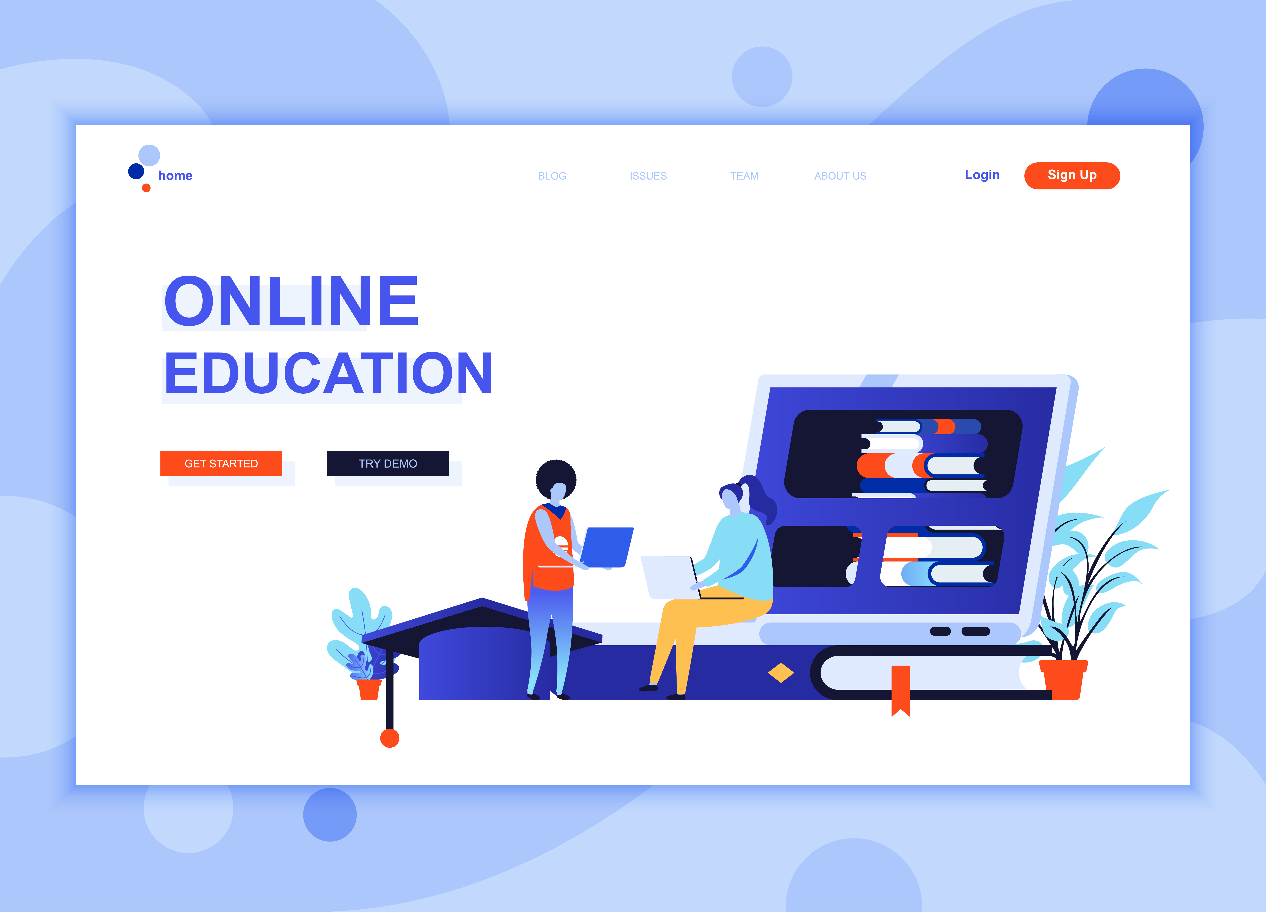
How the World Wide Web Works?
Web Pages
Web pages are HTML documents (.html extension) that are stored on the server. It is not always limited to HTML documents. Some server-side languages, such as PHP and Java, store their web pages as files with the.php or.jsp extension, for example, www.abc.com/xyz.jsp. Regardless of the extension, the final response from the server is always an HTML web page.

Slide 6
How the World Wide Web Works?
Server:
A server is a basic computer that connects to the internet and hosts the content of your website. Small to medium sized websites typically make use of devices like your desktop or laptop. There is no need for a dedicated server; you can turn your desktop computer into one.

Slide 7
Because of this, hosting your website on your desktop is a bad idea.
Your computer must be online constantly (24 hours a day), and you must get power backups and a backup machine in case the primary machine breaks down.
The majority of people do not have a static IP address; instead, our Internet service providers (ISPs) assign us IP addresses, which are constantly changing. The IP address of your server machine is translated into the website address. Therefore, someone else may have been given access to your previous IP address, and the website will now direct users to a different computer.

Slide 8
It is incredibly simple and requires very little technical expertise to host your website on hosting websites like Bluehost, HostGator, Site ground, and many others. Additionally, they offer free support for any problems you may have.
The majority of hosting websites promise 99.9% uptime. Which means that 99.9% of the time, the public will have access to your website.
Cheap web hosting is available.

Slide 9
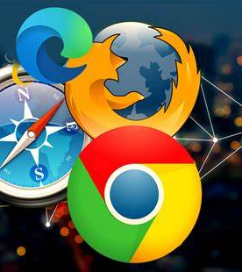
How the World Wide Web Works?
Browser
A browser is the first thing you need in order to view a website (Client). A browser is a piece of software that can connect to a web server, send HTTP requests (requests for specific pages), receive HTTP responses (HTML pages as responses), and display the HTML pages on your screen. Currently, the best browsers are Google Chrome and Firefox.

Slide 10
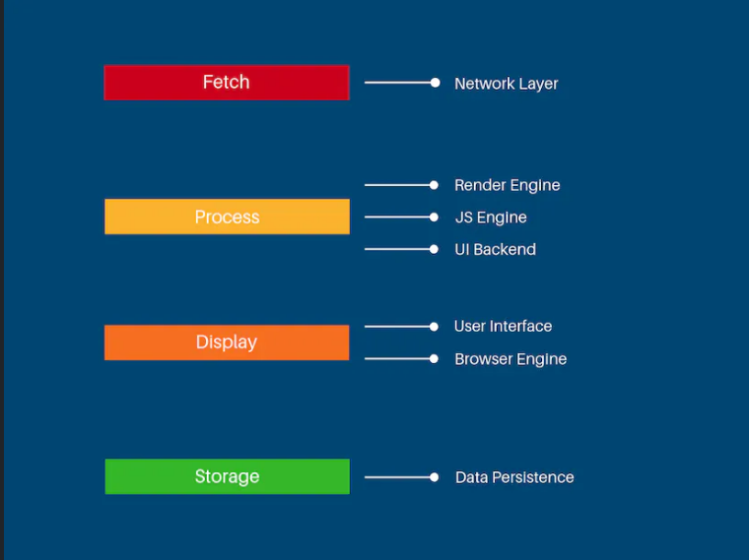
How does a web browser work?
Browsers functionality can be classified into four major sections and these include:
Fetch
Process
Display
Storage

Slide 11
Fetch
A major subsystem known as the network layer is critical in retrieving data from subsequent web servers via the internet. The network layer accepts URLs from the browser's user interface and is in charge of making network calls to retrieve resources using HTTP/FTP protocols. It feeds data to the rendering engine as it becomes available, which is usually done in byte size to improve performance. If the requested website uses caching, a copy of the data is saved in App Cache or Service Workers for future use. Caches are great for fast response times and saving network requests for frequent visits. For requested URLs, the browser first checks for cache availability in local memory. Otherwise, the network layer generates an error.

Slide 12
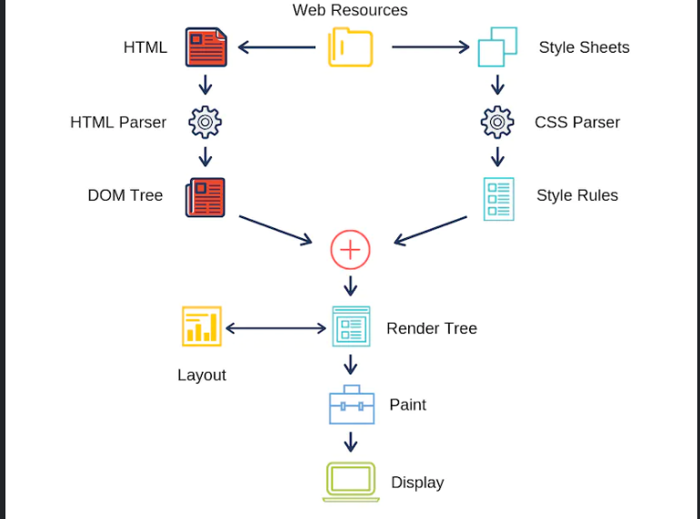
Process
Accepting data from the network layer and feeding it to the display subsystems is what this step entails. The process includes the rendering engine, the JS engine, and the UI backend subsystems.

Slide 13
Web Kit Main Flow
The rendering engine subsystem handles network layer data and displays web content on the screen. It can process HTML, XML, and Image files by default. It can, however, be extended to accommodate different data types via extensions.

Slide 14
A render tree is an object that combines both the parsed HTML and CSS. It is produced with attributes and visual instructions to render elements on the user's screen. The render tree is created, then the output is displayed on the screen after layout and painting are completed.
Calculating the dimensions and precise coordinates of each element's placement on the viewport is a step in the layout process. The layout is painted by adding style attributes like background color, color, and other CSS properties.
The rendering engine breaks up data processing into chunks and shows content as quickly as possible. It won't wait for the layout and painting processes to be completed on the entire document's content.

Slide 15
The JavaScript engine
Using this subsystem, JavaScript code can be translated into machine code and then run. Standard interpreters or JIT (just in time) compilers can be used as these JS engines.
Chrome uses Chrome V8
Safari uses JavaScriptCore
Firefox uses SpiderMonkey
Edge uses Chakra
Internet Explorer uses Chakra (JsScript)

Slide 16
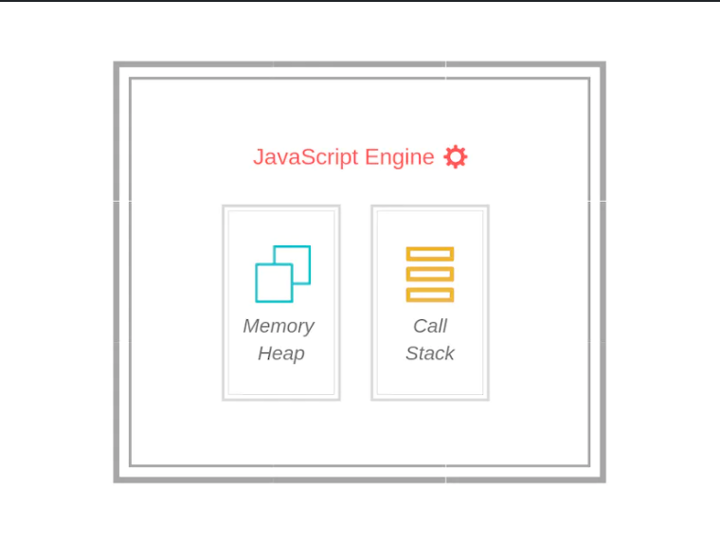
JavaScript Engine
These engines include two components: the memory heap and the call stack.
The memory heap is where memory is allocated for variables, functions and other JS elements.
The call stack is simply a queue of stack frames or sequential steps executed by the browser.

Slide 17
JavaScript is a single-threaded process and each entry or execution step is a stack frame.
These engines have several threads internally to perform various tasks. Examples of such tasks include:
Fetching, compiling and executing code
A profiling thread to analyze functions and their time consumption
Optimizing the execution process
Garbage collectors

Slide 18
Display
This relates presenting data to the users. User Interface and Browser Engine are responsible for data presentation and handling user navigation.
User Experience - The address bar, which accepts web URLs, and navigation buttons like the back, forward, refresh, and home and bookmarks bars are typically included in the browser's visual interface. We also have the viewport (the main portion of the screen), which is used to display content retrieved from websites, in addition to these inputs and action buttons. The User Interface (UI) interacts with other browser subsystems to display content and take appropriate action. On the appearance and feel of the interface, no rules are set. Instead, as browsers improved over time, browser vendors improved the user interface.

Slide 19
The Browser Engine - A high-level interface to the rendering engine is provided by the embeddable browser engine. It loads a specified URL and offers basic browsing features like forward, back, and reloading. Furthermore, it offers hooks for viewing different facets of the browsing session. Observing JavaScript alerts and the progress of the current page load are two examples. The rendering engine settings can also be checked and changed using the browser engine.

Slide 20
Storage
Web browsers have limited storage space that they use to carry out a limited number of operations, cache data, and store data for other browser functionality.

Slide 21
Data Storage
Data persistence is achieved through various browser APIs. Some of them include:
Local storage
Session Storage
Cookies
WebSQL
IndexedDB
FileSystem
AppCache
Service Workers

Slide 22
User Experience
Local storage and Session storage are key-value pairs that can store any JS objects and functions in the browser.
As long as a website session is active, session storage keeps the data on the browser. Local storage is the browser's memory. Until explicitly cleared or changed by the user or JavaScript code, data is persistent.
The 5MB per object and 50MB per system limits apply to both session and local web storage.

Slide 23
Cookies are groups of key-pair information kept in the browser's memory. They are transmitted back and forth between the server and client.
These methods for data persistence are the priciest and least effective. But when it comes to privacy and security, they are very helpful.

Slide 24
Conclusion:
All major web browsers comprise subsystems, along with other submodules to help with the process.
These systems are involved from accepting the web URLs, to displaying web content on the screen. They make network calls, fetch resources, parse HTML, CSS, and JavaScript files to create objects to render on the screen. These all combine to produce a wonderful browser for the user.

